Slide 1
Hierarchical Clustering

Slide 2
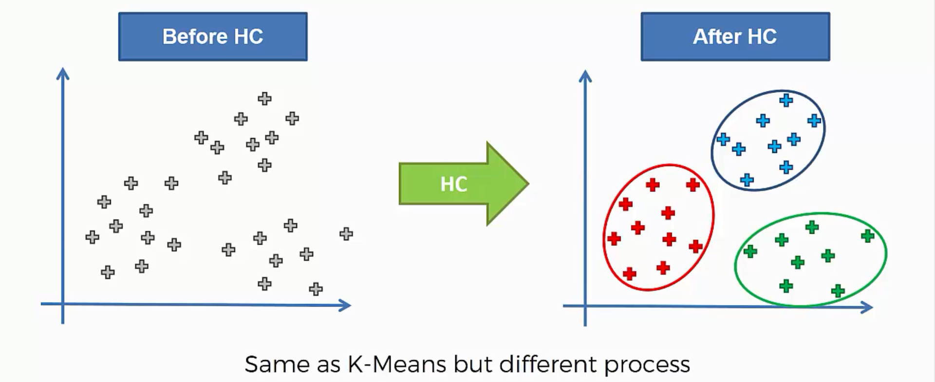
What does Hierarchical Clustering do?

Slide 3
Steps to perform Hierarchical Clustering
Step 1: Make each data point a single-point cluster. This gives us N clusters, where N is the number of data points in the entire dataset.
Step 2: Take the two closest data points and make them one cluster. That results in N-1 clusters.
Step 3: Take the two closest clusters and make them into one cluster.
Step 4: Repeat Step 3 until there is only one cluster.
Finish: Clusters are ready.

Slide 4
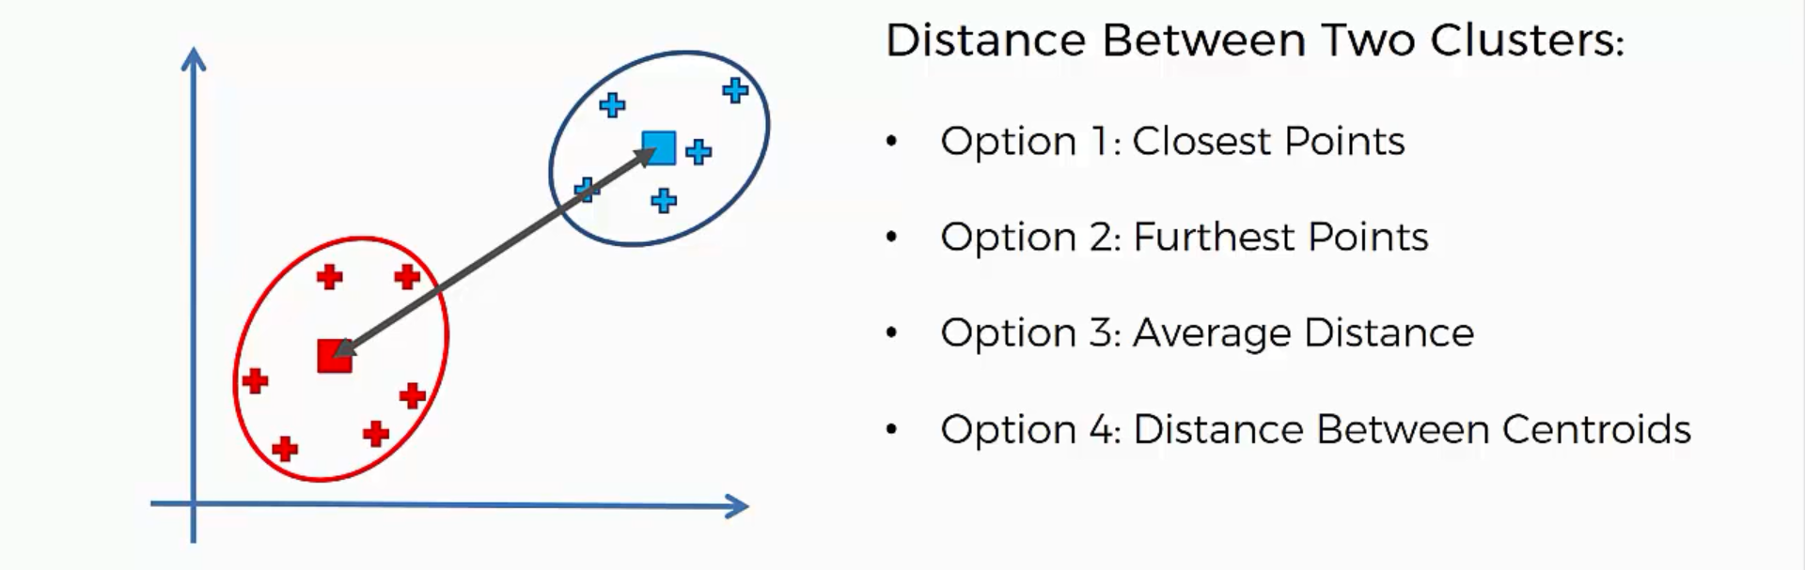
What does inter-cluster distance mean?

Slide 5
Illustrative Example
Hierarchical Clustering

Slide 6
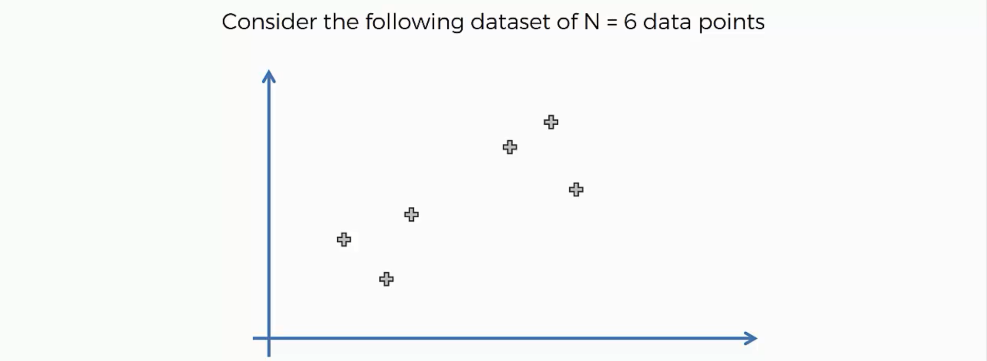
Hierarchical Clustering in action

Slide 7
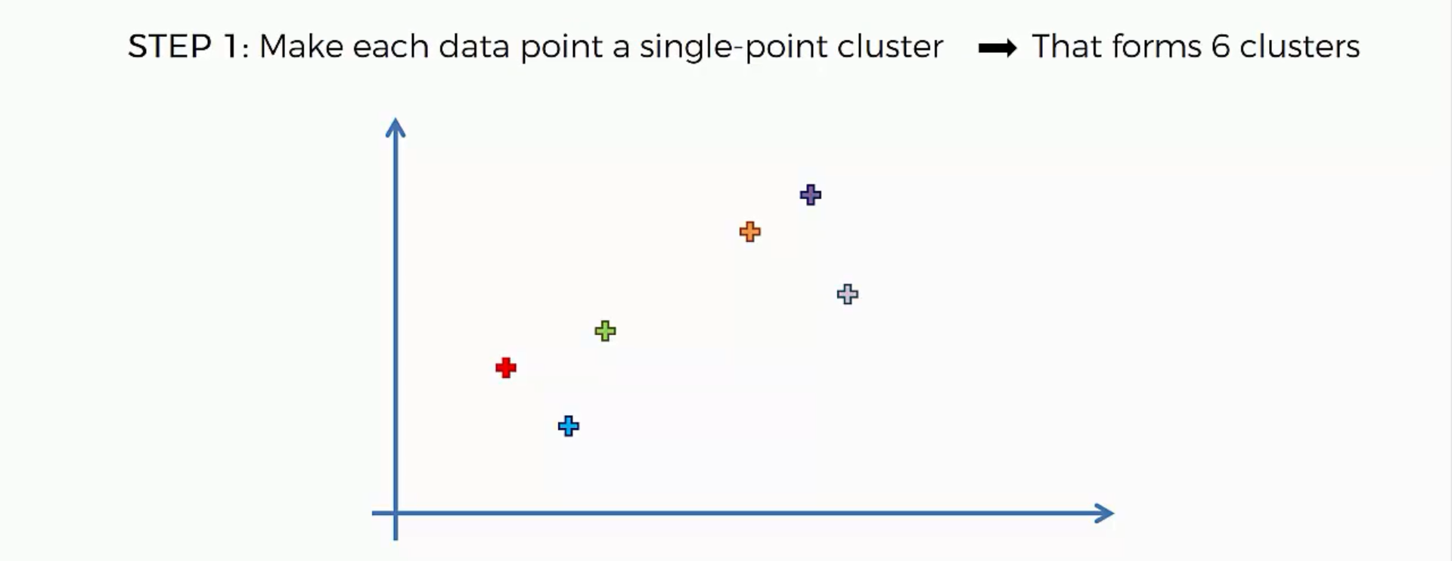
Hierarchical Clustering in action

Slide 8
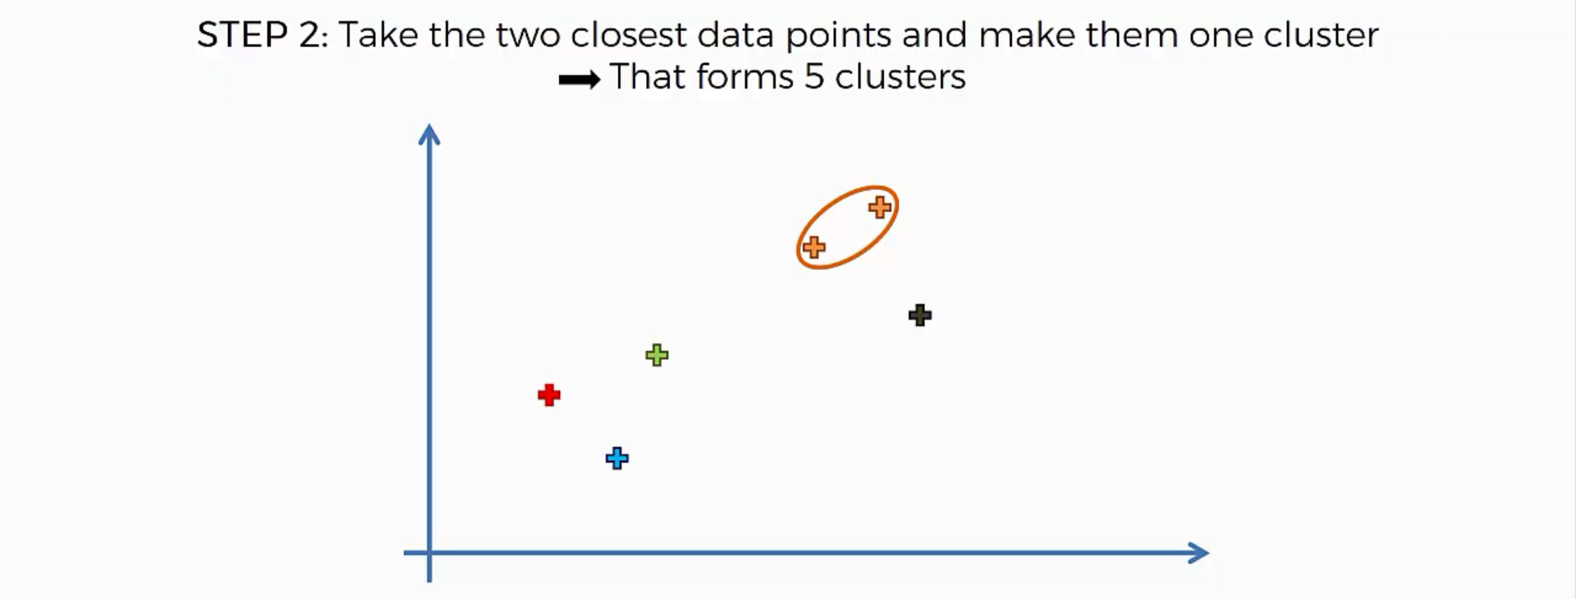
Hierarchical Clustering in action

Slide 9
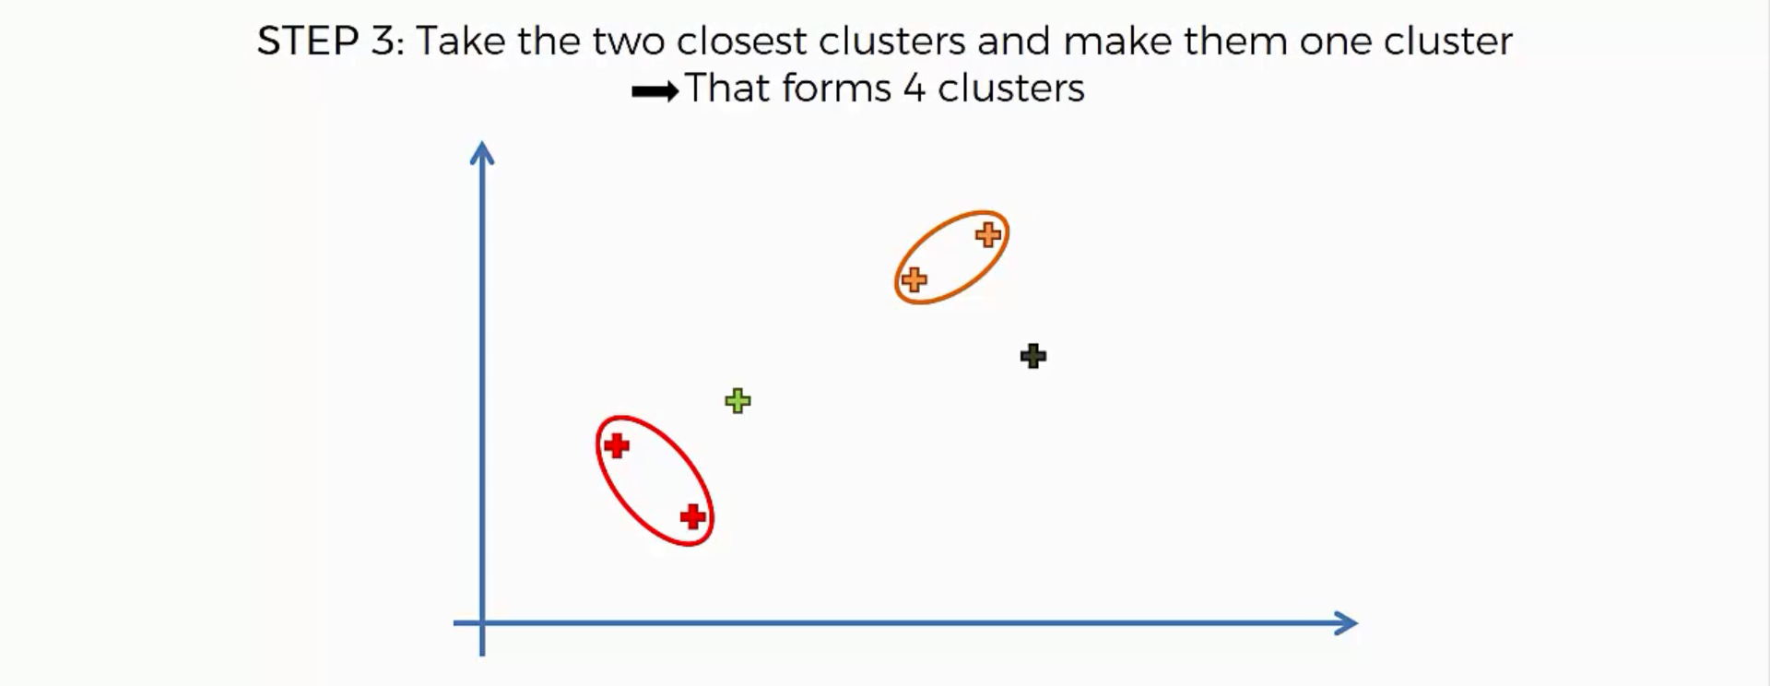
Hierarchical Clustering in action

Slide 10
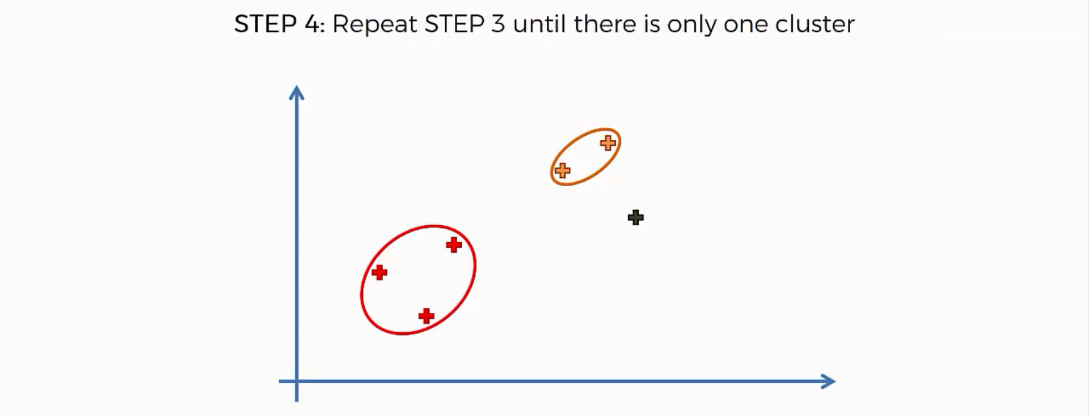
Hierarchical Clustering in action

Slide 11

Hierarchical Clustering in action

Slide 12
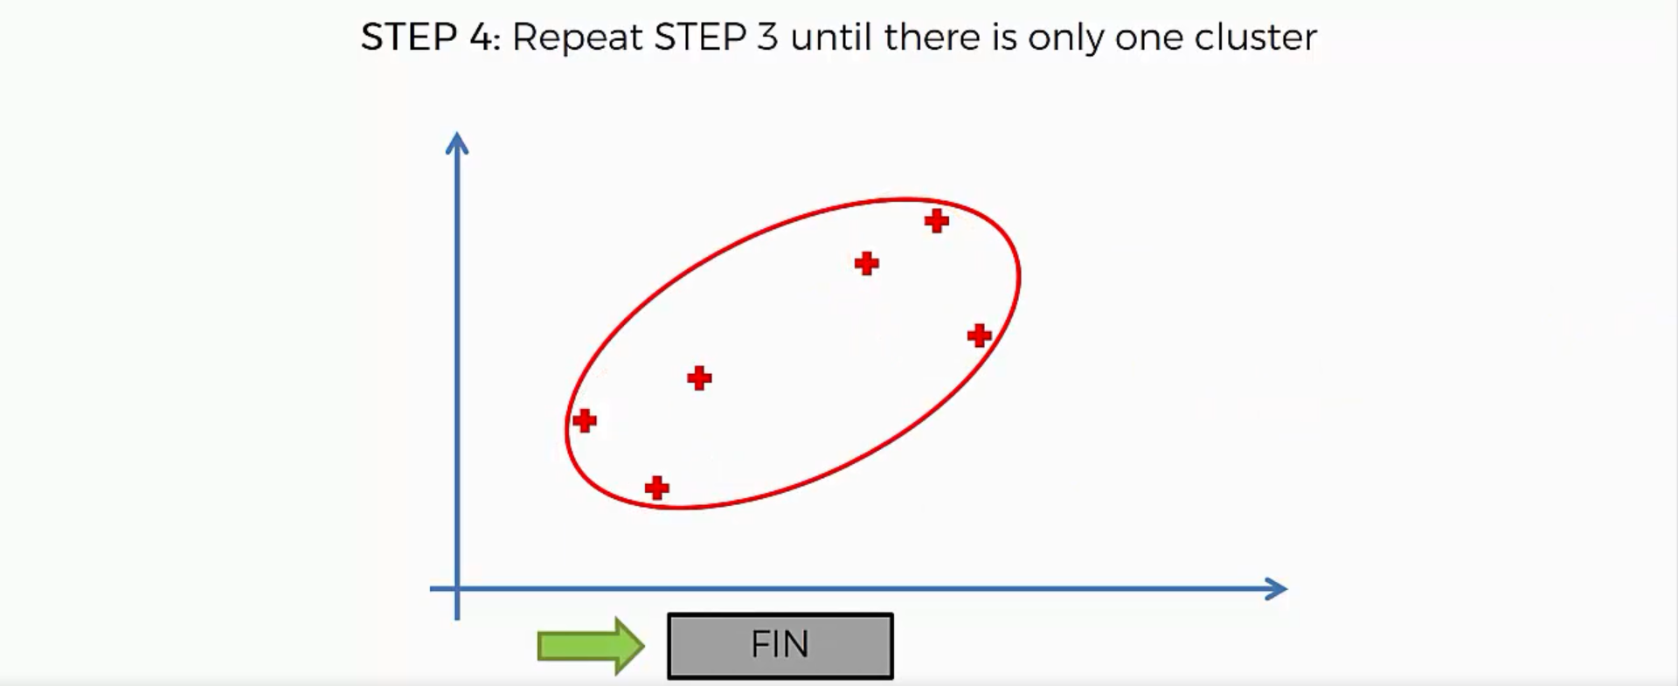
Hierarchical Clustering in action

Slide 13
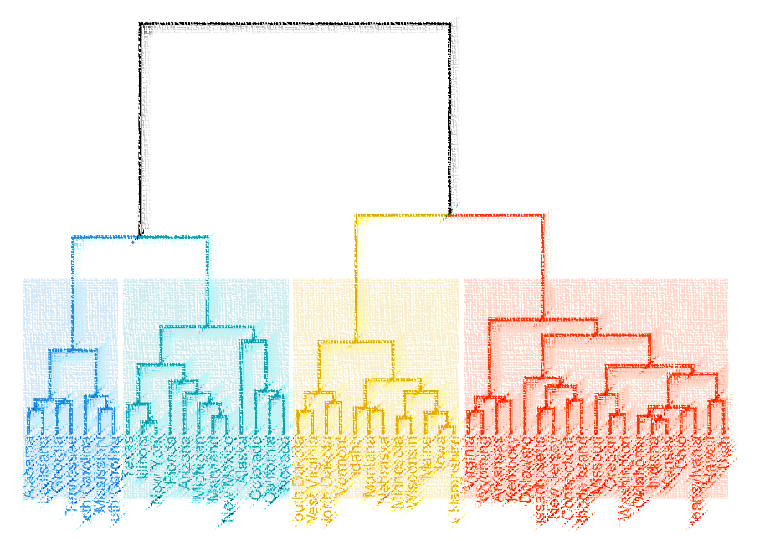
Dendograms
The memory of Hierarchical Clustering Algorithm

Slide 14
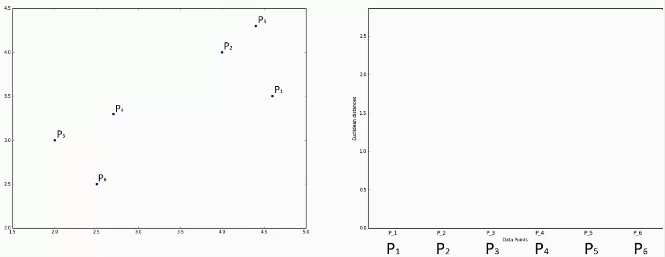

Slide 15
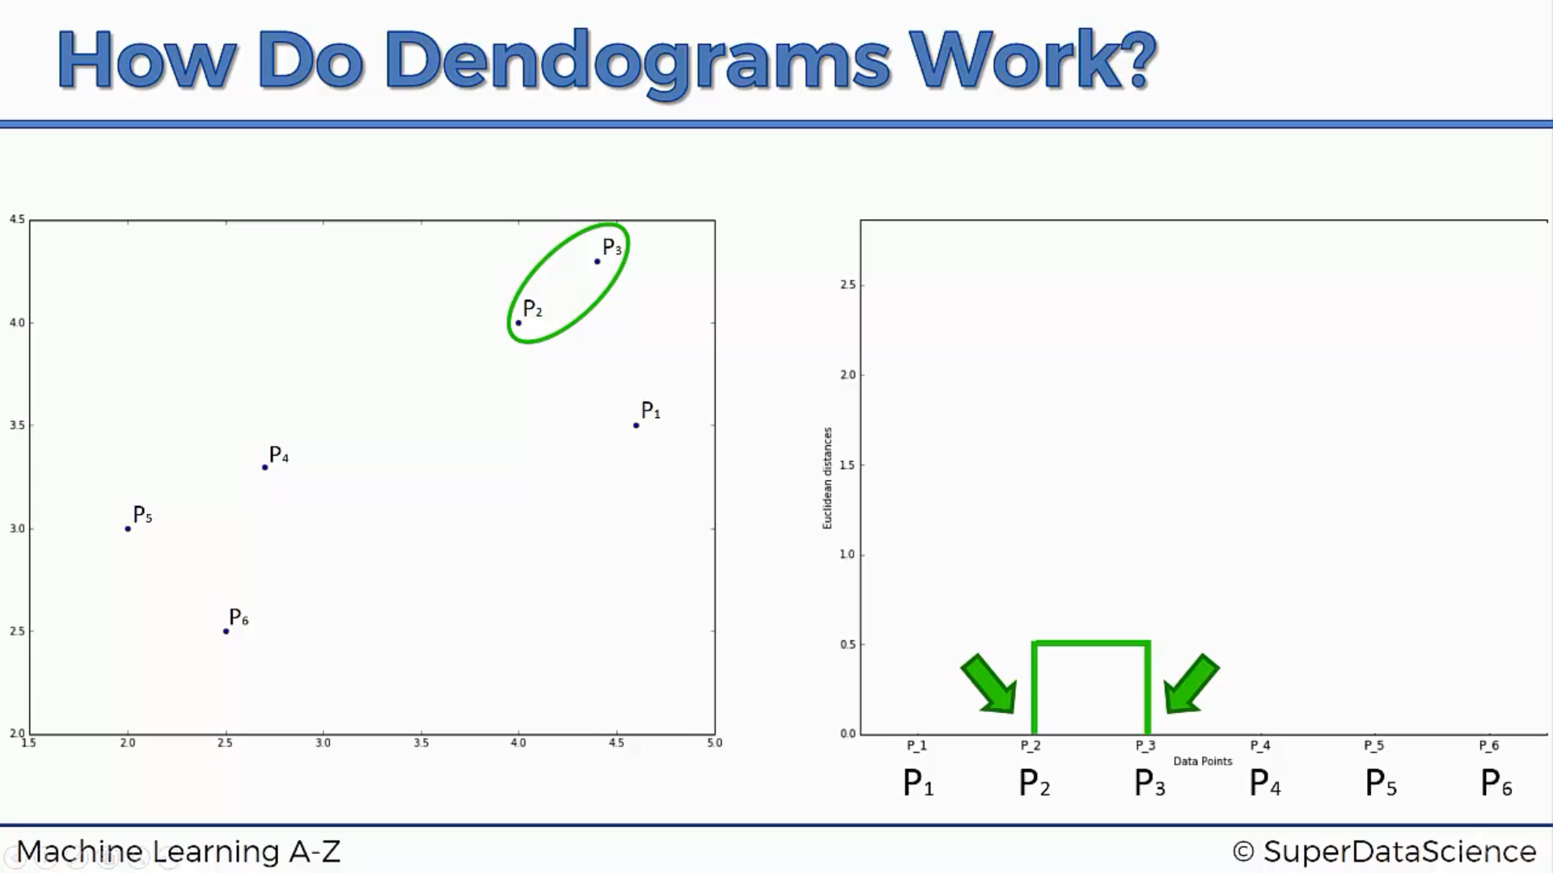
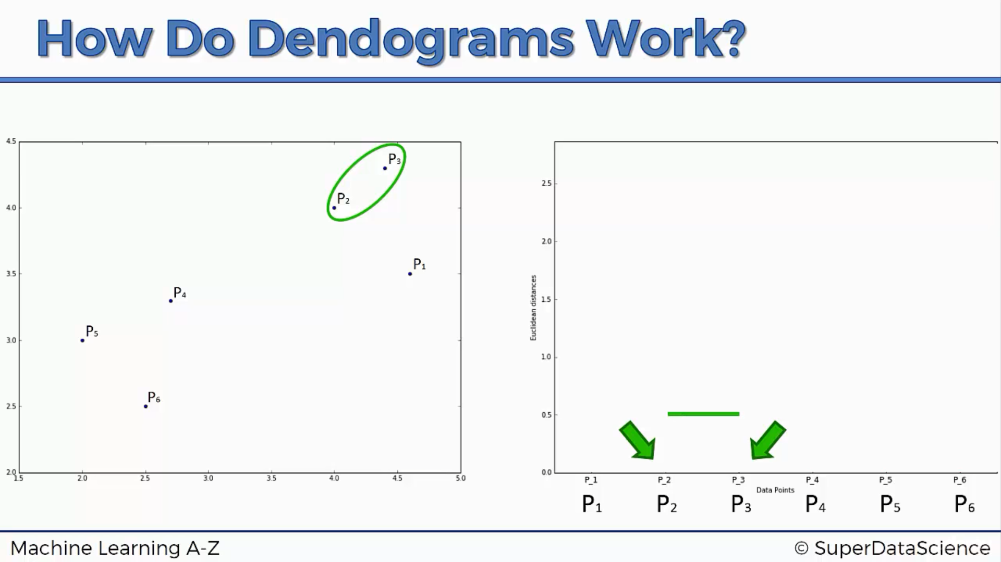
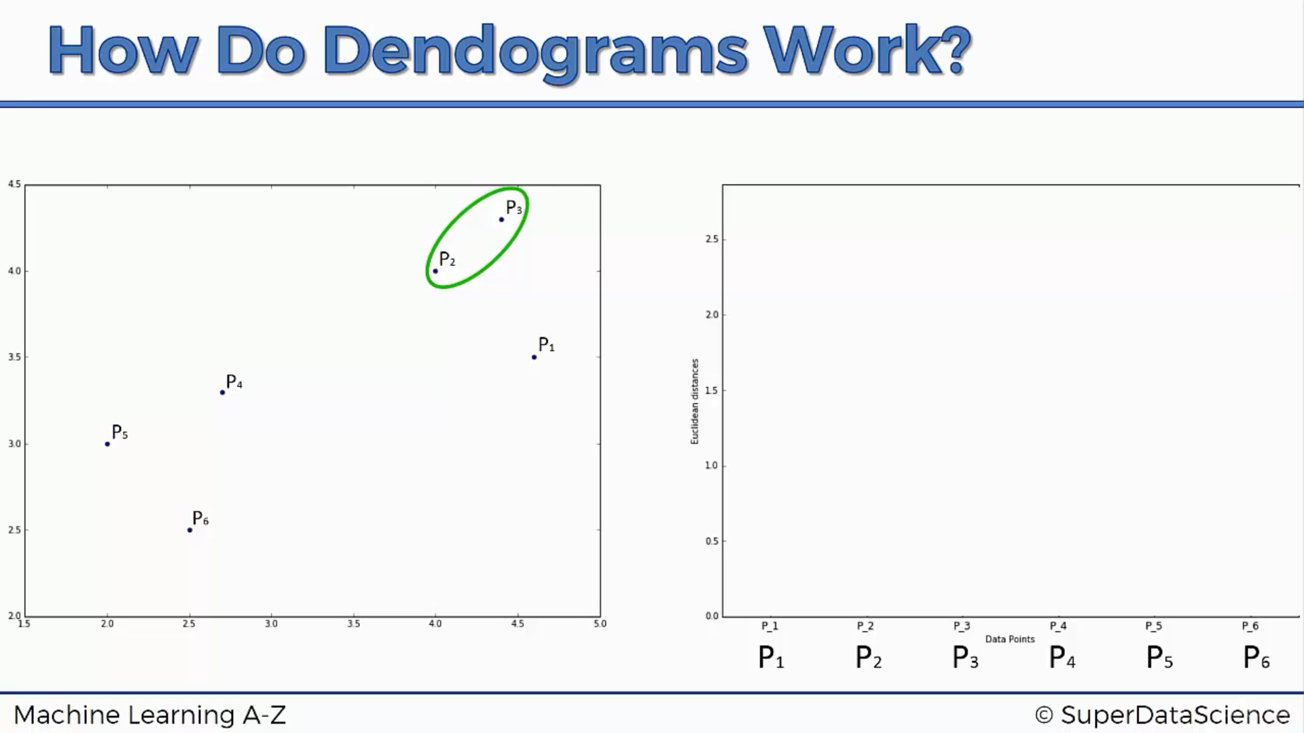

Slide 16
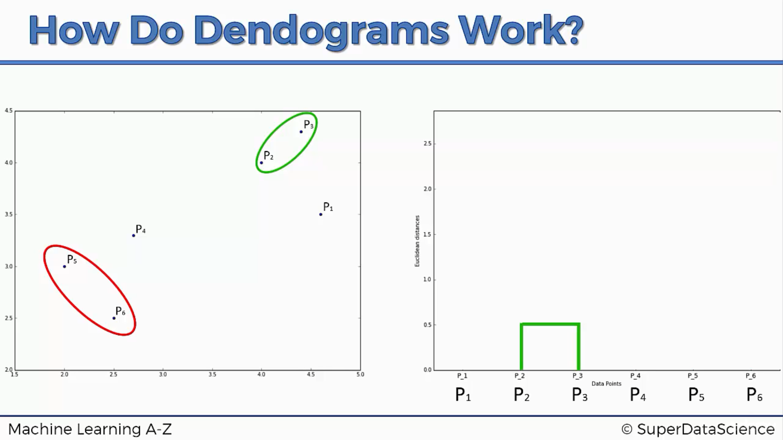
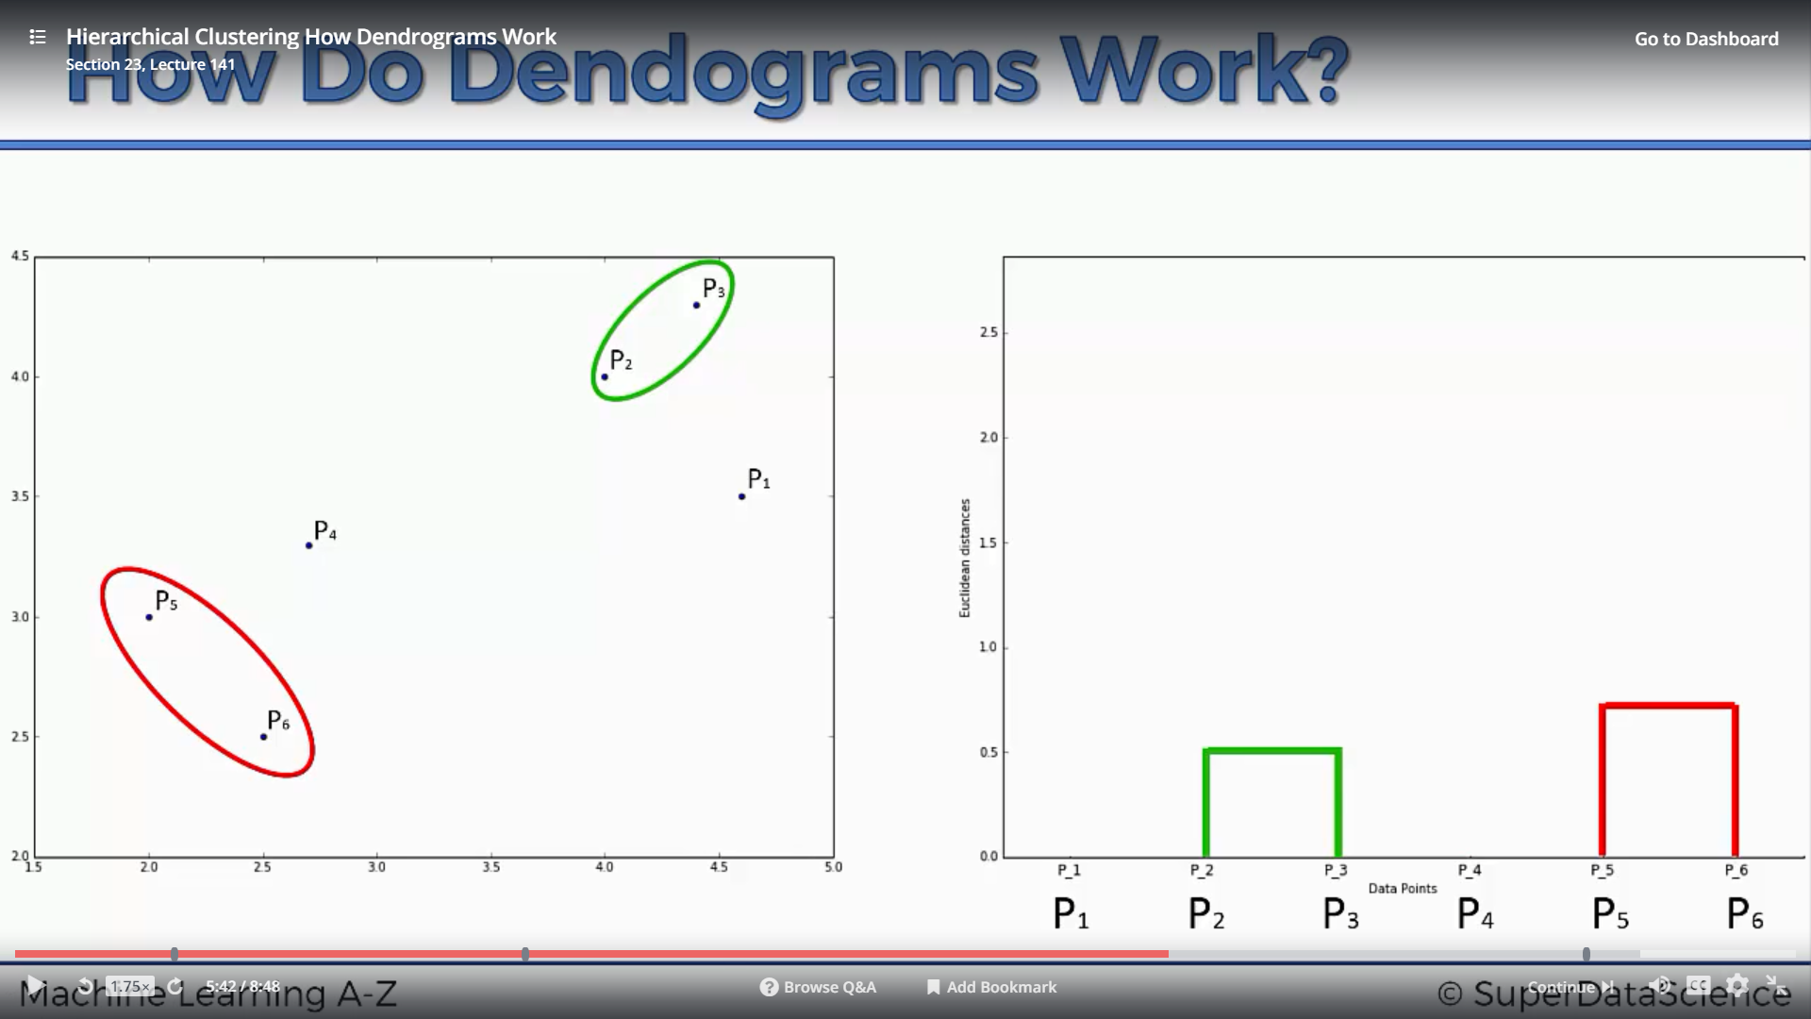

Slide 17
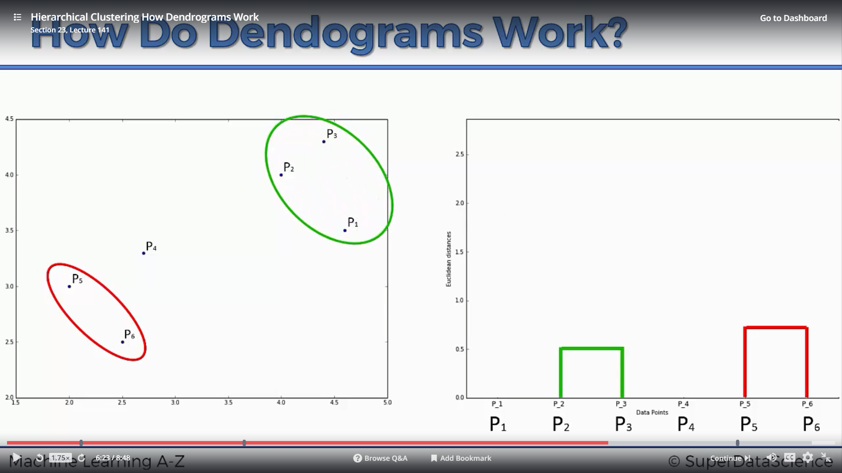
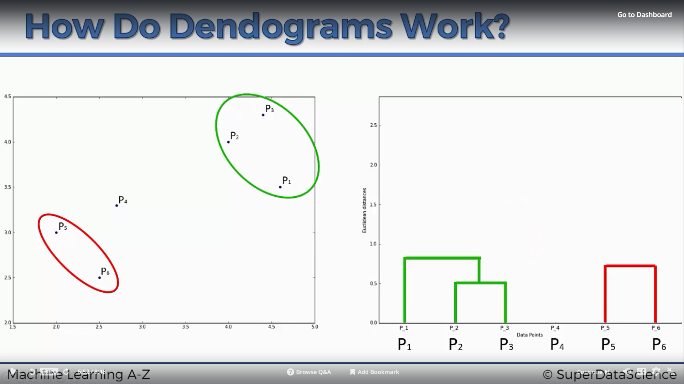

Slide 18
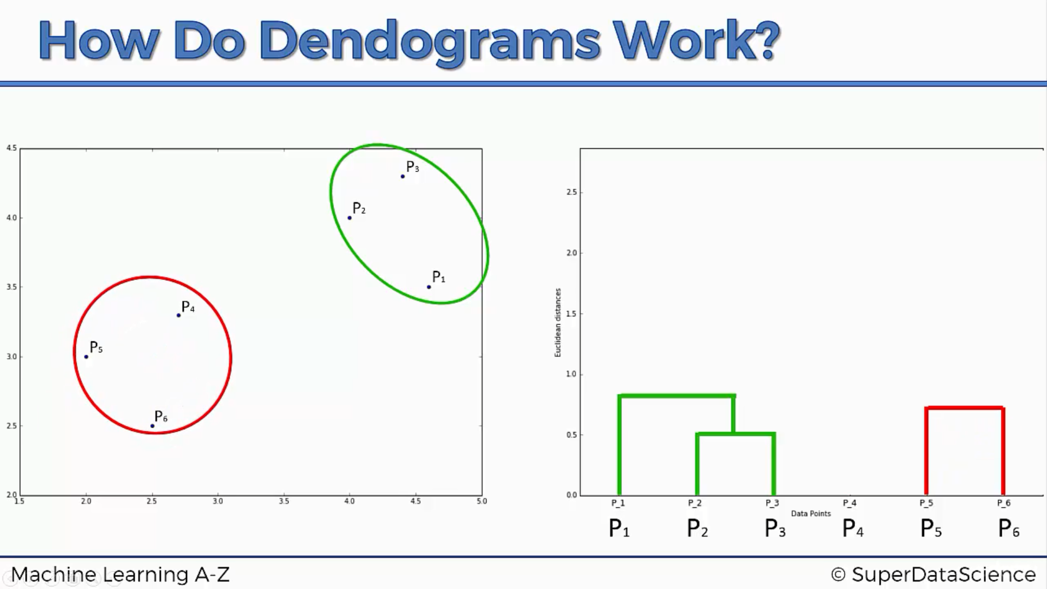
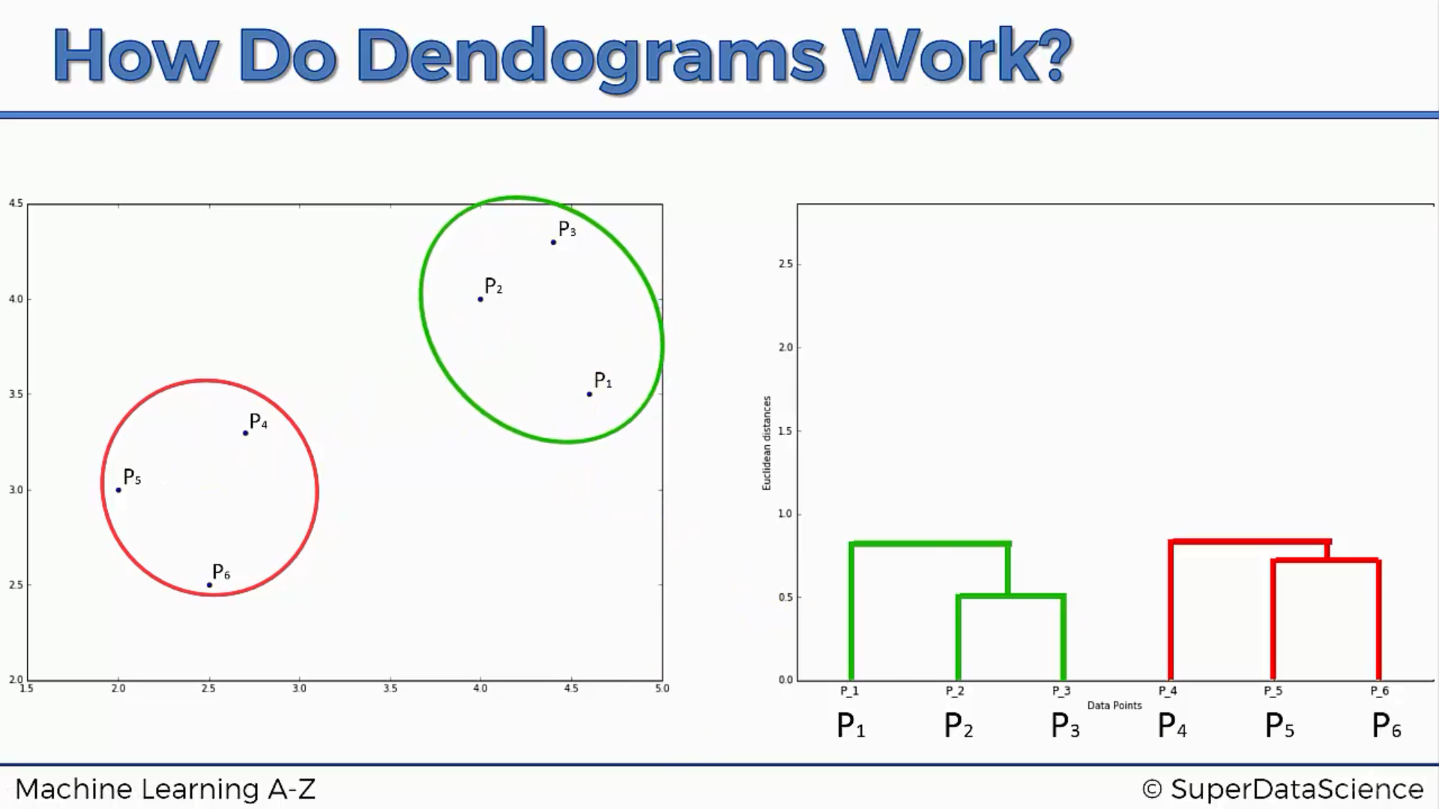

Slide 19
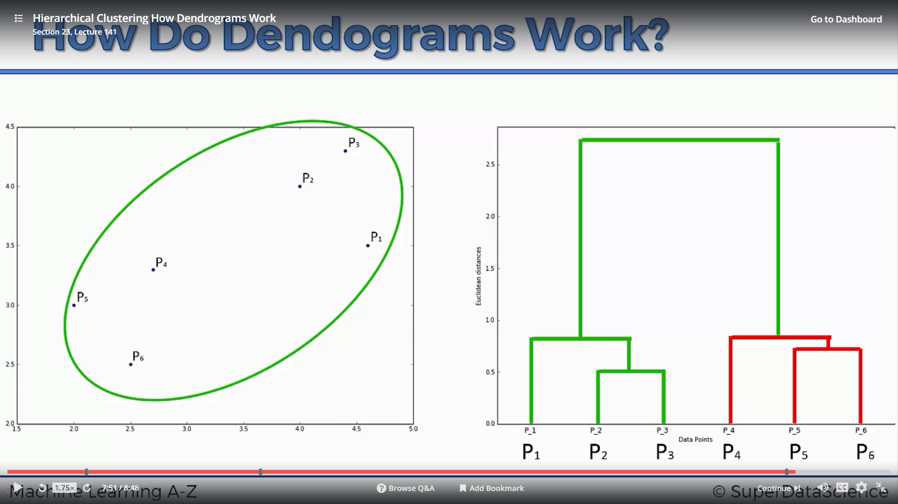
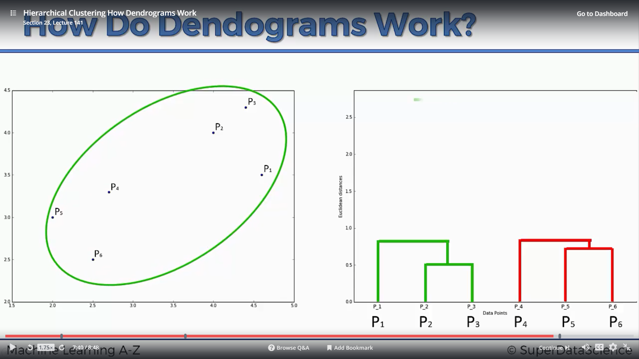

Slide 20
Choosing the right number of clusters
How to find the best number of clusters that can completely segregate the dataset

Slide 21
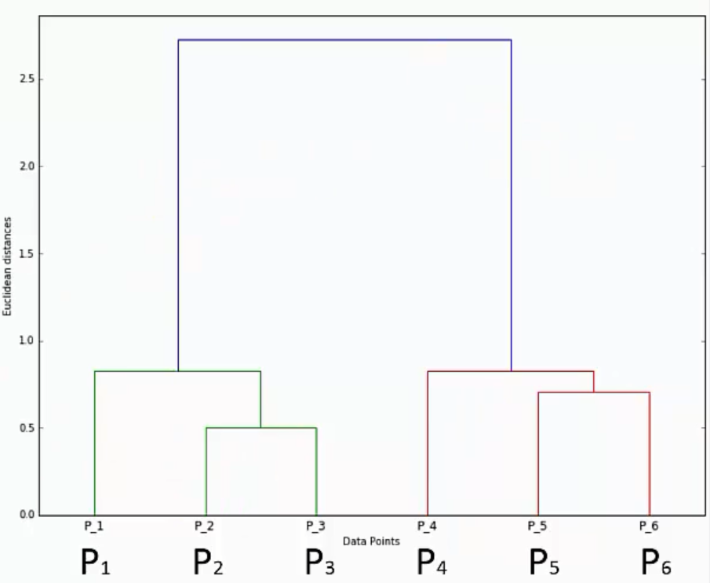

Slide 23
Knowledge Test
Can you identify the number of clusters by looking at the dendogram?

Slide 24
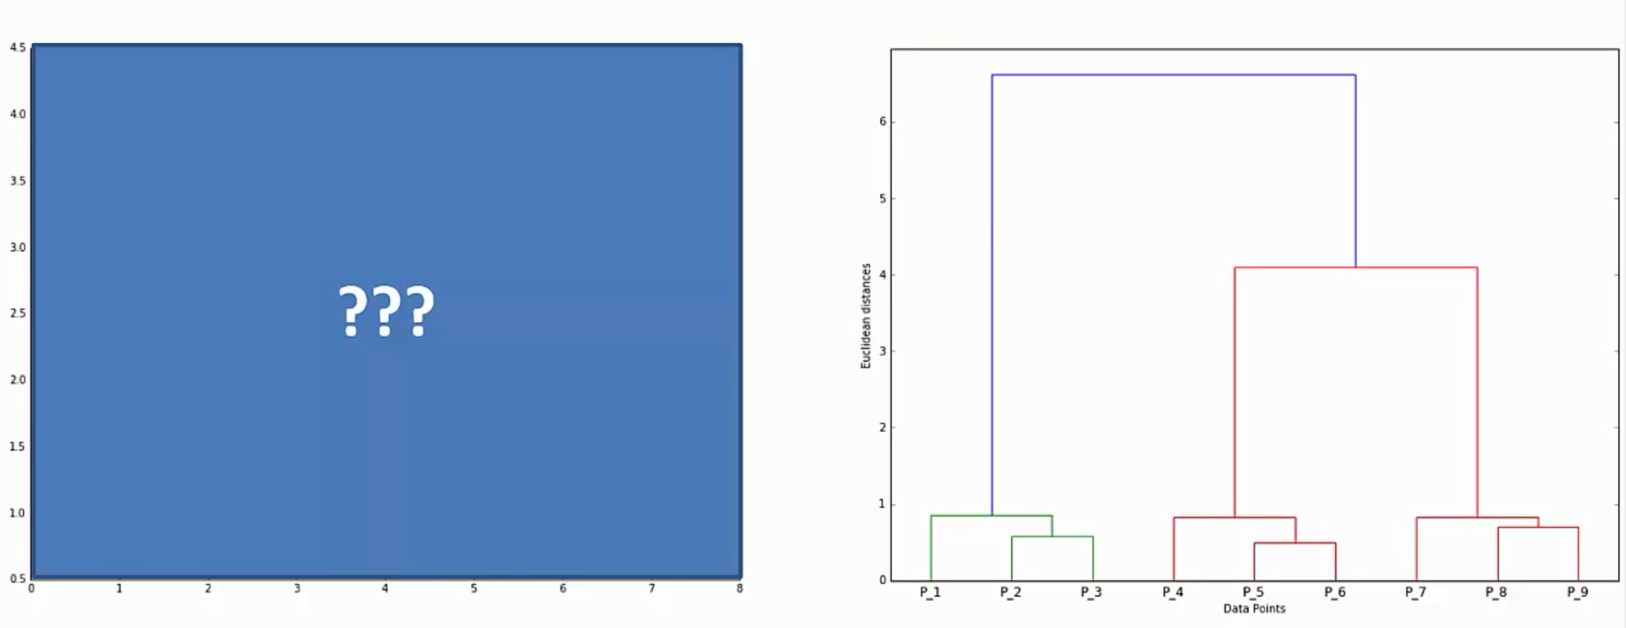
How many clusters are there?

Slide 25
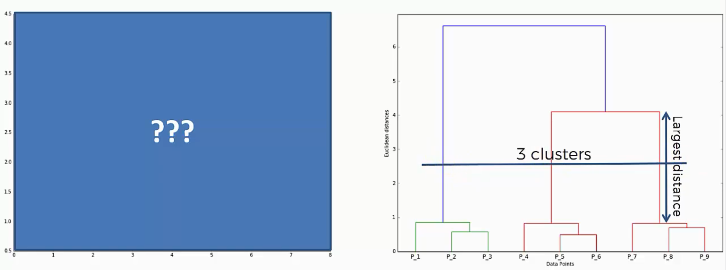
Interpreting the dendogram

Slide 26
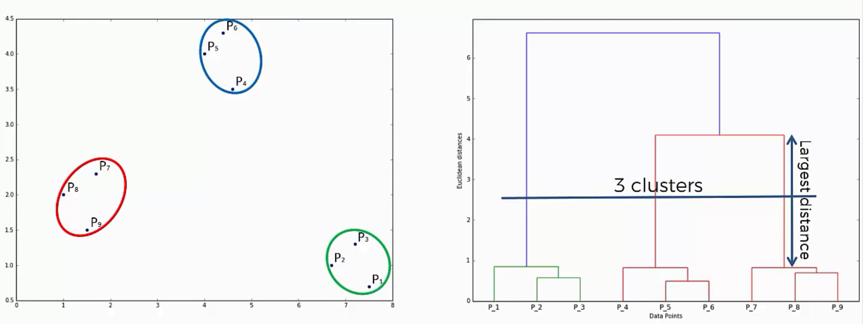
Looks like we were right!

